Slide 1
COMPUTER VISION & OBJECT DETECTION
Smart Waste Detection
Real-time multi-class material categorization using YOLO26 Nano.
Local Project (Pre-Release)

Slide 2

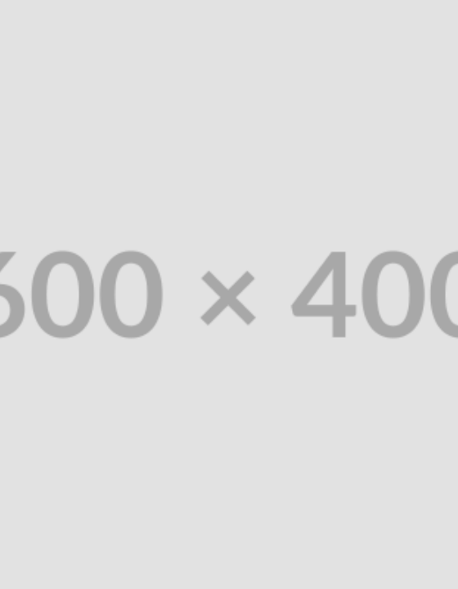
THE PROBLEM
Inefficient Sorting
Contamination: Mixed waste streams ruin recyclable batches.
Manual Bottlenecks: Human sorting is slow and hazardous.
Ecological Impact: Missed recovery of biodegradable matter.

Slide 3

Solution Objectives
6-Class Categorization Framework
Instant Vision
Biodegradable
Cardboard
Glass
Metal
Paper
Real-time automated inference.
Plastic

Slide 4






Application Stack
Python
FastAPI
Ultralytics
Web Frontend
YOLO26 Nano

Slide 5
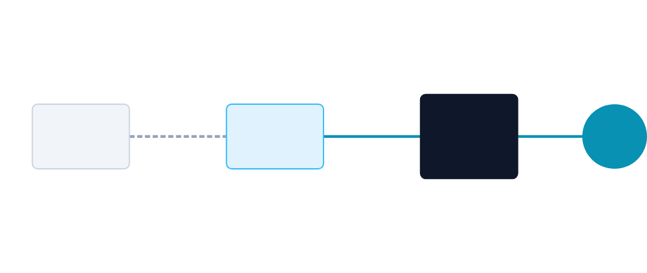
System Architecture
Bounding
Boxes
HTML/JS
FastAPI
YOLO26 Nano
Client Interface
REST Endpoint
Model Weights

Slide 6




Inference Workflow
1. Capture
2. Preprocess
3. Predict
4. Render
Receive raw waste image.
Resize and normalize tensors.
YOLO26 forward pass.
Draw boxes on frontend UI.

Slide 7

Detection Algorithm
Utilizing Ultralytics YOLO26 Nano architecture for single-stage object detection, optimized for speed and low-compute environments.
One-Stage Architecture: Simultaneous bounding box & class prediction.
Nano Variant: Reduced parameters for real-time edge inference.
Augmentation: Mosaic and mixup training for robustness.

Slide 8
MODEL PERFORMANCE
Held-Out Test Metrics
75.8%
61.6%
69.1%
48.8%
Precision (75.85%)
Recall (61.67%)
mAP@50 (69.14%)
mAP@50-95 (48.87%)

Slide 9

Application Interface
HTML/JS frontend consuming FastAPI inference endpoints to visualize bounding boxes and confidence scores in real-time.

Slide 10


Validation & Limitations
Testing Success
Real-World Limitations
Passed exactly 10 automated application tests.
Occlusion: Overlapping waste causes missed detections.
API routing, payload validation, and core inference functions verified.
Lighting Sensitivity: Shadows misclassify materials.
Class Confusion: Transparent plastic vs. glass errors.

Slide 11
Technical Q&A
1. Why choose YOLO26 Nano?
4. Precision vs. Recall trade-off here?
Optimizes inference speed for real-time edge deployment constraints.
High precision ensures sorting purity; low recall means some recyclables are missed.
2. Explain mAP@50?
Mean Average Precision where Intersection over Union (IoU) > 0.50.
5. Mitigation for real-world occlusion?
Requires physical vibratory separation on the belt before camera capture.
3. How does FastAPI improve this architecture?
Provides async handling and high-throughput REST endpoints.

Slide 12

Scalable Vision for Sustainability.
Demonstrating the viability of edge-deployed computer vision in solving physical-world ecological challenges.
Local Deployment V1.0
tmthangaraj1980

Slide 13


Image Sources
https://images.unsplash.com/photo-1532996122724-e3c354a0b15b?crop=entropy&cs=tinysrgb&fit=max&fm=jpg&ixid=M3w1ODg1Mjh8MHwxfHNlYXJjaHwyfHxVcmJhbiUyMHdhc3RlJTIwbWFuYWdlbWVudCUyMHBvbGx1dGlvbiUyMHByb2JsZW0lMjBhYnN0cmFjdCUyMHBob3RvfGVufDB8fHx8MTcxOTQwNDQ5MHww&ixlib=rb-4.0.3&q=80&w=1080
Source: unsplash.com
https://media.licdn.com/dms/image/C4D12AQExyO-o8F-PMA/article-cover_image-shrink_720_1280/0/1628172983790?e=2147483647&v=beta&t=37yT-F3o3g4oF6H8iR-uH-j1V4nE9V_D_3M190yA8zE
Source: www.linkedin.com
https://media.licdn.com/dms/image/D4D12AQG44L949Hl1bw/article-cover_image-shrink_720_1280/0/1715694218671?e=2147483647&v=beta&t=p8o-22a4-x6A7R5r1Q7n6lE1QG1Y7T_7k2C0J6t8n4
Source: www.linkedin.com

